Slide 1
Introduction
Classified Performance Appraisals
Protective Services [NP-5]
Department of Human Resources, Labor Relations
Summer 2025

Slide 2

What is a Performance Appraisal?
Written evaluation of the employee’s performance over a specified time period.
This Photo by Unknown Author is licensed under CC BY-SA

Slide 3
When should they be conducted?
Initial or promotional working test period (before the end of the working test period).
Annually, by October 1st. Annual increments are awarded on January 1st.
As needed:
    To address specific performance issues
    To recognize performance improvement
    To restore annual increase
    At such times as it is determined that the quality of service of an employee should be recorded; at the discretion of the supervisor.

Slide 4
When do I prepare an annual evaluation?
August 1 to August 31: Supervisor prepares the performance appraisal (PA) by completing the form in Kuali.
September 1 to September 15: Designated command staff review and approve in Kuali. Make changes if necessary.
On or before September 15: Completed PA is sent to Labor Relations through Kuali for review. PA is returned to the supervisor to review with the employee.
Before October 1st, the supervisor and the employee review the PA and the employee signs it in Kuali.
The fully signed PA is processed within Kuali and filed in the official personnel record.

Slide 5
Performance Appraisal
Process
Completed and signed by Supervisor
Reviewed and signed by designated command staff
LR reviews and approves; sends original back to department
Supervisor conducts the performance appraisal interview
Employee reviews & signs*
Original Completed/signed form is processed by HR within Kuali
*Employees should be reminded that their signature does not necessarily indicate approval or agreement with the rating, only that they have seen it. If an employee refuses to sign the rating, contact LR for instructions.

Slide 6
Purpose - Why do we do Performance Appraisals?
Opportunity for the supervisor to provide employees with a knowledge of their performance over time.
The interview to discuss the PA with the employee should be private, and enough time should be allotted for a real conversation.
This is the opportunity for the supervisor to:
Identify strengths and/or areas of concern
Clarify job expectation
Coach and counsel
Provide positive feedback for satisfactory performance
Discuss problem areas with employees whose performance is less than good
Remember to provide specific examples rather than speaking in general terms.

Slide 7
Performance Appraisal Interview
Reminder:
Always conduct in private
Opportunity for manager:
Set goals for the upcoming year
Review goals met from past evaluation year
Provide positive feedback and communicate areas of improvement
Opportunity for employee:
Ask their supervisor for tips or other guidance on how to be successful in their position
Ask how to progress through the ranks of the department

Slide 8
Performance Appraisal vs. Discipline
Performance appraisals are not discipline and should not be used as a punitive tool. Discipline should be handled at the time of the incident, not the annual performance appraisal.
Instead, performance appraisals:
  Written culmination of an on-going feedback and observations documented throughout the evaluation period.
  May be used to point out areas of weakness and to counsel on corrective action.
  Final outcome should not come as a surprise to employee.
However, progressive discipline may be warranted when:
  There are performance problems, attendance problems, misconduct or issues and must be addressed by supervisors in a timely manner.
  Should discipline be issued, it may be used to support “less than good” ratings in the evaluation; however, it is a separate process.

Slide 9
What do I put in a performance appraisal?
Evaluating Performance – Supervisor Best Practices
Supervisors should evaluate regularly and avoid only providing feedback annually
  Coach and counsel
  Positive and constructive feedback
  Allow a space for employees to approach with questions or feedback
  Model behavior
  Fair and impartial with evaluations
  Consistent in addressing performance
Avoid making comments in performance appraisal that are inconsistent with the rating
Performance Appraisal Interviews
  Should not be the first employee learns of problems
  Should be a review of conversations that have already taken place throughout the evaluation period

Slide 10
Performance Appraisal
Initial Working Test Period
Permanent positions are required to serve an initial six (6) month working test period.
For satisfactory performance - performance appraisal should be filled out not less than two (2) weeks prior to the end of the probationary period.
Failure to complete evaluation will default employees to permanent.
Crucial for supervisors to address performance problems during the working test period as soon as possible.
    Ideally, at the first sign of problems in performance or attendance the supervisor should document this in their own files.
    If the employee's performance does not improve, they can be dismissed at any time during the working test period.
Important note: please do not wait until the end of the working test period to address poor performance or attendance issues.
For unsatisfactory performance during the working test period, involve Labor Relations.

Slide 11
Performance Appraisal
Promotional Working Test Period
Employees promoted will serve a 4-month promotional working test period.
For employees who successfully complete their promotional working test period, a service rating should be filed at the end of the four (4) month period.
For an employee whose performance has been less than good, failure of a promotional working test period has varying implications.
Failure to complete evaluation will default employees to permanent.

Slide 12
Performance Appraisal
Working Test Period Extensions
Extensions
  Initial & Promotion
  Extensions do not normally extend beyond three months; may be as long as six (6) months
  Common Reasons
    Completing training academy
    Completing Field Training
    On a performance improvement plan
  Requests must be submitted to Labor Relations four (4) weeks prior to the end of the working test period

Slide 13
Points for filling out the form
The Performance Appraisal form is in Kuali.
It includes the same information as the State of Connecticut form that the Department must use for annual evaluations.
There are “Job Elements” that require ratings of 3 levels of “Good” and 2 levels of “less than good.”
You will check the appropriate box for each job element, and you may note whether the employee has gotten better, stayed the same or gotten worse over the last year.
You may add notes in “Other Elements” if there is something additional that you want to be part of the record.
Include comments to provide additional information to the employee.

Slide 14
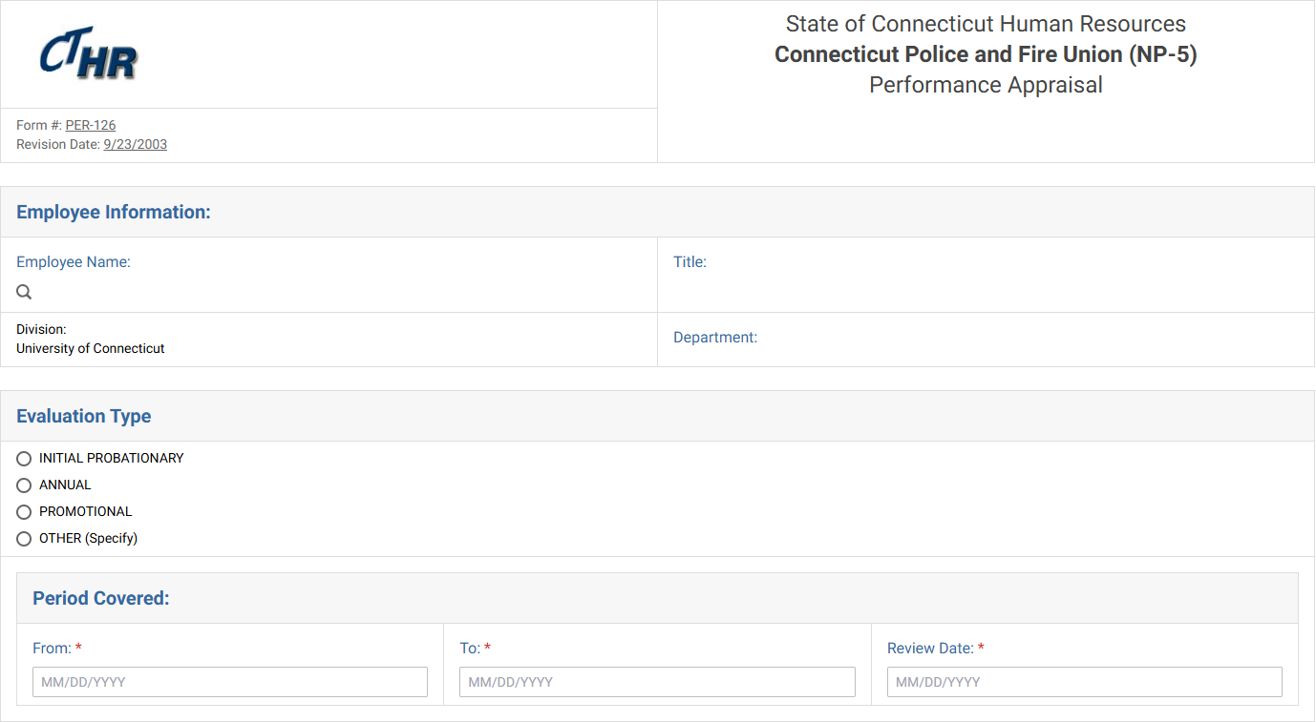
Performance Appraisal
Employee info and type of performance appraisal:

Slide 15
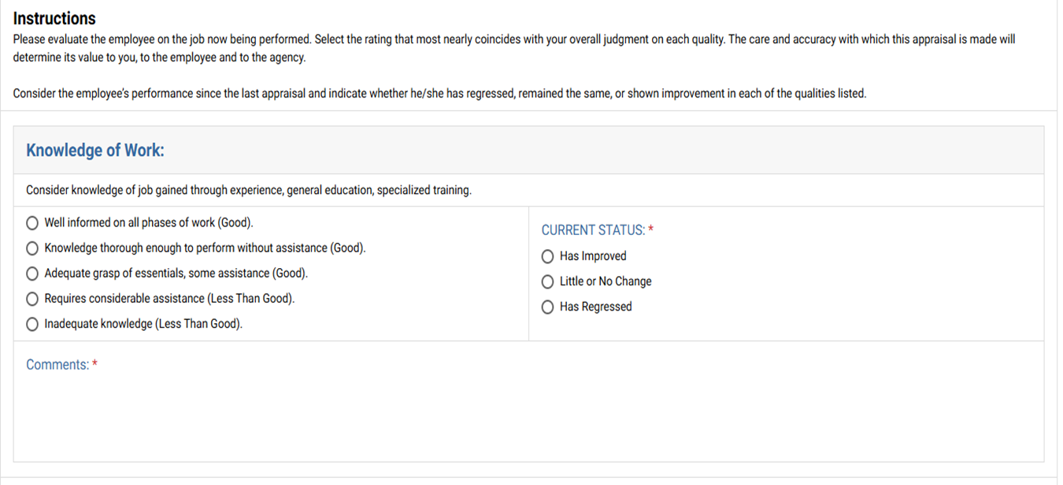
Performance Appraisal
Job Elements
& Ratings:

Slide 16
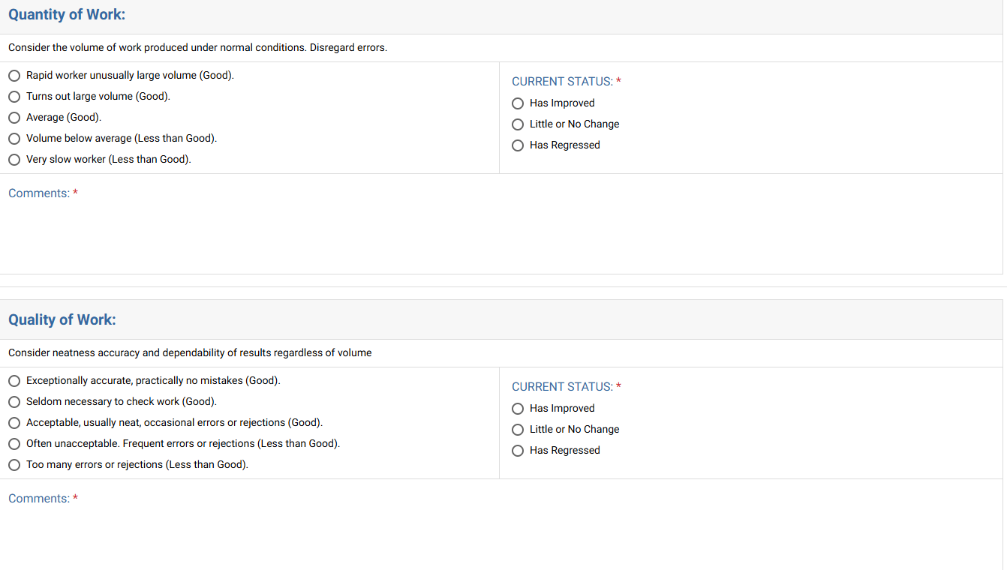
Performance Appraisal
Job Elements
& Ratings:

Slide 17
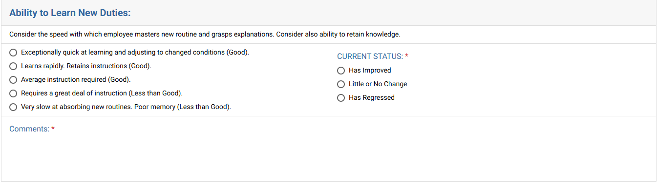
Performance Appraisal
Job Elements
& Ratings:

Slide 18
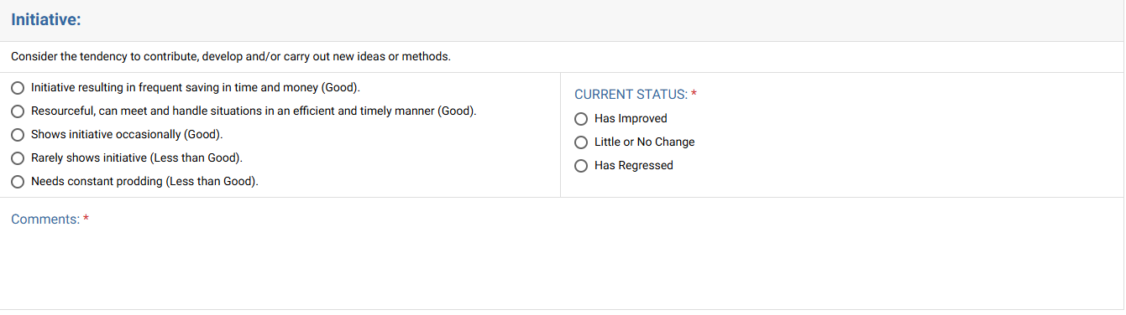
Performance Appraisal
Job Elements
& Ratings:

Slide 19
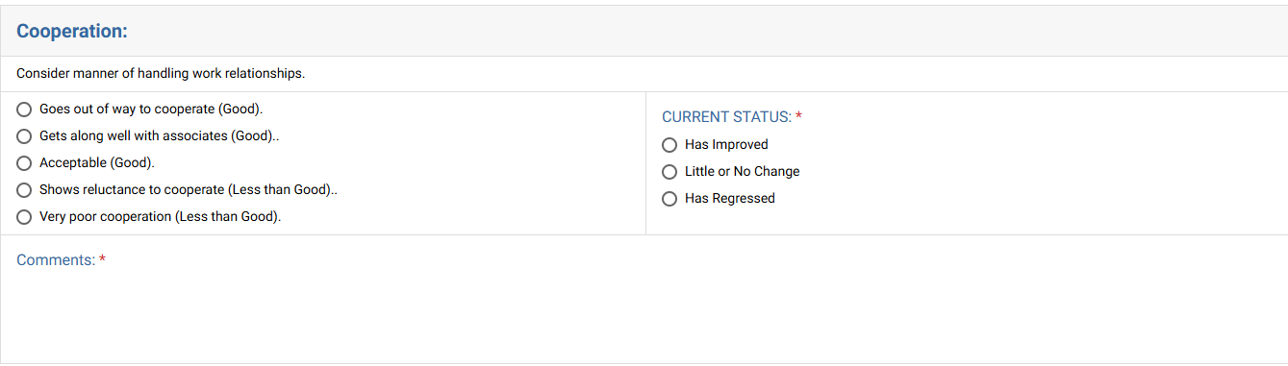
Performance Appraisal
Job Elements
& Ratings:

Slide 20
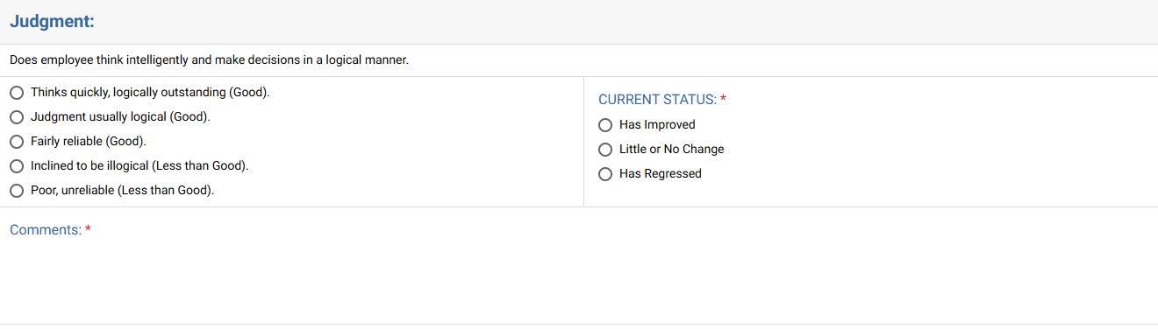
Performance Appraisal
Job Elements
& Ratings:

Slide 21
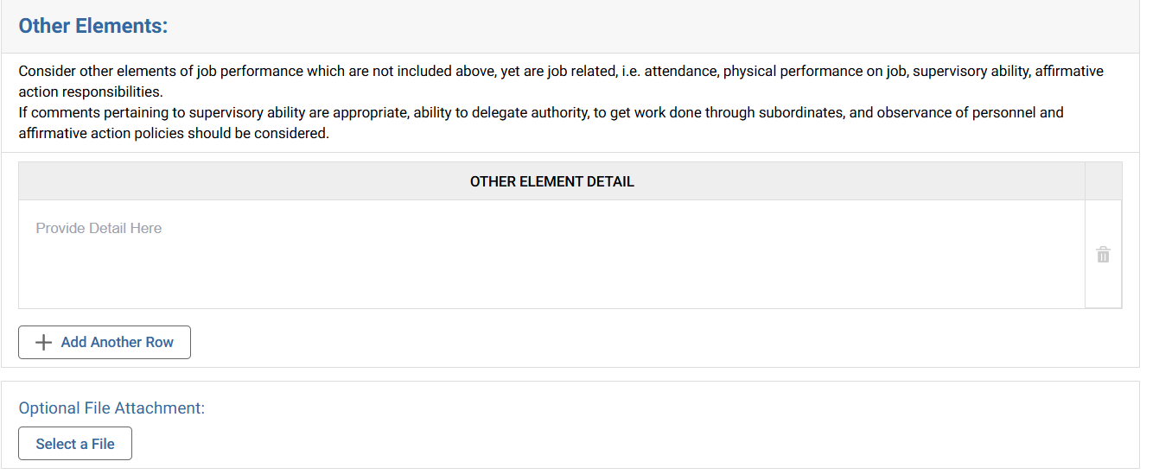
Performance Appraisal
Job Elements
& Ratings:

Slide 22
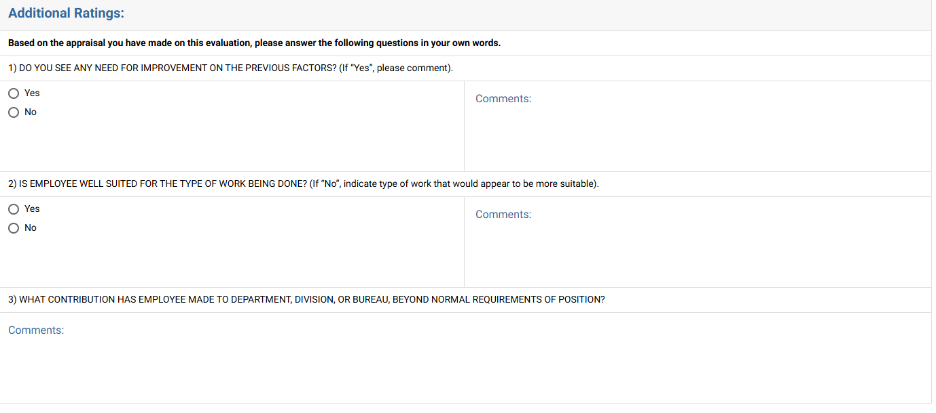
Performance Appraisal
Please be sure to take into consideration discipline that has been documented for this evaluation period.

Slide 23
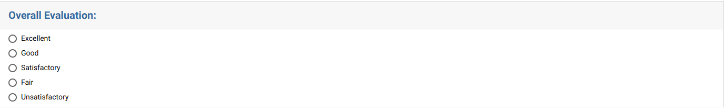
Performance Appraisal
Supervisory feedback & overall evaluation of employee:

Slide 24
Performance Appraisal
Consequences of “Less Than Good and “Unsatisfactory” ratings
A “Less Than Good” performance appraisal may mean that an employee is not eligible for an anniversary increase, promotion, or transfer. The supervisor should make it known to Labor Relations (laborrelations@uconn.edu or 486- 5684) if an increase is to be denied for a LESS THAN GOOD rating.
An “Unsatisfactory” rating may result in the denial of an increase. Two consecutive unsatisfactory ratings, filed within two years of each other, may be cause for dismissal.

Slide 25
Performance Appraisal
“Less Than Good” Performance
Before filing a "less than good" performance appraisal, supervisors should call Labor Relations at ext. 5684 or laborrelations@uconn.edu for guidance.
Supervisors should be able to answer "yes" to the following questions before filing a "less than good" rating:
Is the employee working within his/her job specification?
Have the University's and the department's rules, regulations and policies been explained to the employee? Is there documentation as to when and how?
Has the employee been given adequate training in order to perform his/her duties?
Have performance problems been pointed out to the employee and suggestions for improvement been made? Is there documentation to show dates of counseling sessions and progressive discipline? Has a letter of warning specifically referencing the possibility of a "less than good" rating been given to the employee?
Has the employee been given sufficient time and opportunity to improve his/her performance?
Is the rating an objective evaluation?

Slide 26
Performance Appraisal
Evaluating Attendance
Attendance rating based on:
  (1) The number of days and occasions (Guidance on Attendance),
  (2) an employee's tardiness record, and
  (3) any unauthorized leave
Excessive use of sick leave should be evaluated considering the following factors:
  (1) number of days taken, and number of occasions,
  (2) pattern of usage,
  (3) the employee's past record,
  (4) the reasons for sick leave use, and
  (5) extenuating circumstances.
For employees whose attendance needs improvement, copies of counseling letters and/or medical certificate requirements and warnings should be attached to the rating.

Slide 27
Overall Rating
Then you give an overall evaluation of the employee. You may select:
Excellent
Good
Satisfactory
Fair
Unsatisfactory
Only fair or unsatisfactory ratings may be grieved.

Slide 28
“Fair” or “Unsatisfactory” Ratings
A rating of “unsatisfactory” in one category or “fair” in two categories means that the appraisal is considered “less than good,” and you may only make the overall rating “fair” or “unsatisfactory.
When deciding eligibility for an annual increment, a single unsatisfactory or two (2) fair ratings may be considered grounds for denial of such step.

Slide 29
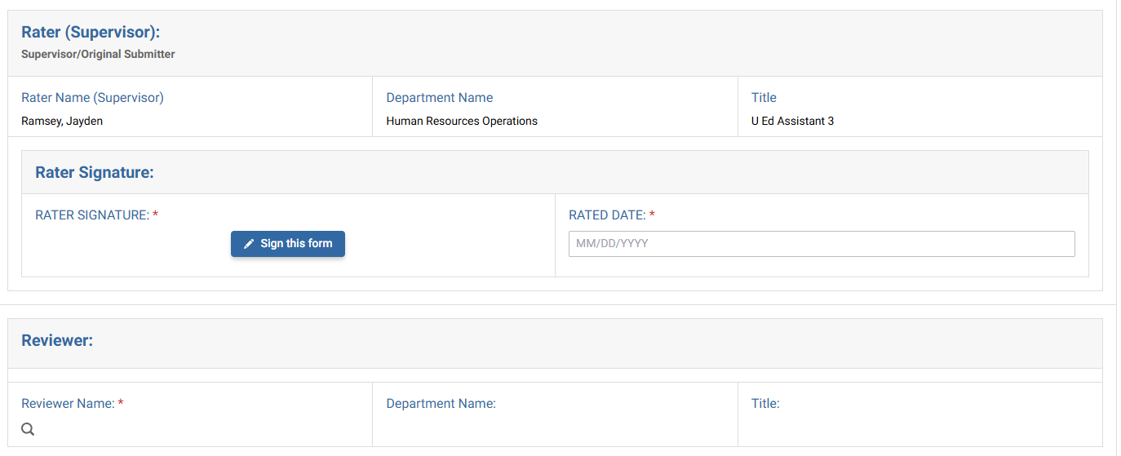
Performance Appraisal
Signatures:
Supervisor who completes the evaluation.
Designated command
staff
Optional reviewers within Kuali acknowledge the form; their signature is not included.

Slide 30
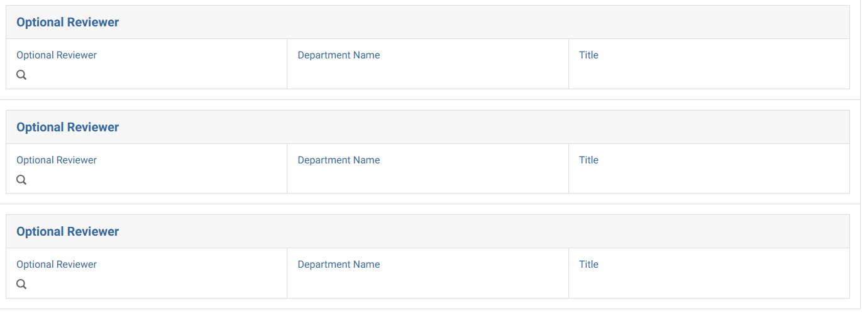
Performance Appraisal
The review will route through Optional Reviewer 1, then Optional Reviewer 2, and then Optional Reviewer 3 if annotated. It will skip to the next step if not selected.

Slide 31
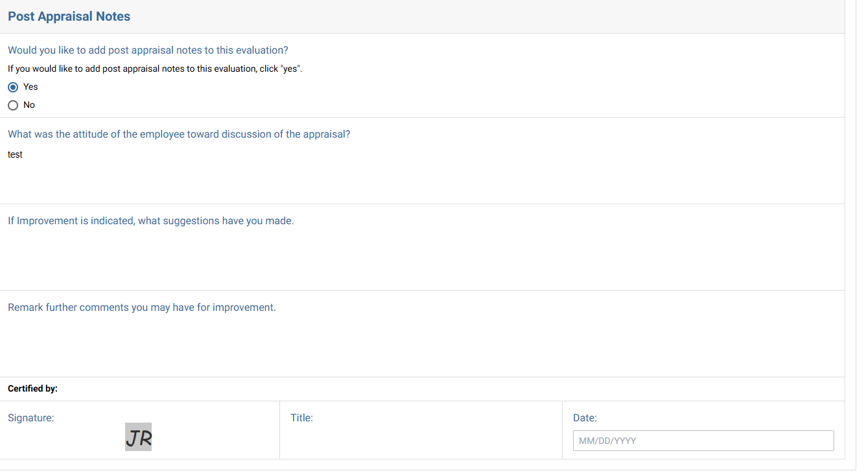

Performance Appraisal
Post discussion notes:

Slide 32

Questions
This Photo by Unknown Author is licensed under CC BY

