Slide 1
Classified Performance Appraisals
NP-3 Administrative Clerical
Presented by the Department of Human Resources,
Labor Relations

Slide 2

What is a Performance Appraisal?
A written evaluation of the employee’s performance over a specified time period
This Photo by Unknown Author is licensed under CC BY-SA

Slide 3
When should performance appraisals (PAs) be conducted?
Before the end of an initial or promotional working test period
Annually, by October 1st (annual increments are awarded on January 1st)
As needed:
  To address specific performance issues
  To recognize performance improvement
  To restore an annual increase
At such times as it is determined that the quality of service of an employee should be recorded; at the discretion of the supervisor

Slide 4
When do I prepare an annual evaluation?
August 1 to August 31: Supervisor prepares the performance appraisal (PA) by completing the form in Kuali.
September 1 to September 15: Designated command staff review and approve in Kuali. Make changes if necessary.
On or before September 15: Completed PA is sent to Labor Relations through Kuali for review. PA is returned to the supervisor to review with the employee.
Before October 1st, the supervisor and the employee review the PA and the employee signs it in Kuali.
The fully signed PA is processed within Kuali and filed in the official personnel record.

Slide 5
Performance Appraisal Process
Completed and signed by Supervisor
Reviewed and signed by designated Manager
LR reviews and approves; sends original back to department
Supervisor conducts the performance appraisal interview
Employee reviews & signs*
Original Completed/signed form is processed by HR within Kuali
*Employees should be reminded that their signature does not necessarily indicate approval or agreement with the rating, only that they have seen it. If an employee refuses to sign the rating, please contact Labor Relations.

Slide 6
Purpose: Why do we do performance appraisals?
PAs are an opportunity for supervisors to provide employees with a knowledge of their performance over time.
The interview to discuss the PA with the employee should be private; enough time should be allotted for a real conversation.
This is the opportunity for the supervisor to:
  Identify strengths and/or areas of concern
  Clarify job expectation
  Coach and counsel
  Provide positive feedback for satisfactory performance
  Discuss problem areas with employees whose performance is less than good
Remember to provide specific examples rather than speaking in general terms.

Slide 7
Performance Appraisal Interview
Opportunity for the manager to:
  Set goals for the upcoming year
  Review goals met for past evaluation year
  Provide positive feedback and communicate areas of improvement
Opportunity for the employee to:
  Ask their supervisor for tips or other guidance on how to be successful in their position
  Ask how to progress through the ranks of the department
Reminder: always conduct in private

Slide 8
Performance Appraisal vs. Discipline
Performance appraisals are not discipline and should not be used as a punitive tool. Discipline should be handled at the time of the incident, not the annual performance appraisal.
Instead, performance appraisals:
  Serve as a written culmination of on-going feedback and observations documented throughout the evaluation period
  May be used to point out areas of weakness and to counsel on corrective action
  Final outcome should not come as a surprise to employee
However, progressive discipline may be warranted when:
  There are performance problems, attendance problems, misconduct, or issues and must be addressed in a timely manner
  Should discipline be issued, it may be used to support “less than good” ratings in the evaluation; however, it is a separate process

Slide 9
What do I put in a performance appraisal?
Evaluating Performance-Supervisor Best Practices
Supervisors should evaluate regularly and avoid only providing feedback annually
  Coach and counsel
  Positive and constructive feedback
  Allow a space for employees to approach with questions or feedback
  Model behavior
  Fair and impartial with evaluations
  Consistent in addressing performance
Avoid making comments in performance appraisal that are inconsistent with the rating
Performance appraisal interviews:
  Should not be the first employee learns of problems
  Should be a review of conversations that have already taken place throughout the evaluation period
If discipline has been issued during the evaluation period, it should be reflected in the service rating

Slide 10
Performance Appraisal
Initial Working Test Period
Permanent positions are required to serve an initial six (6) month working test period
For satisfactory performance, the PA should be filled out not less than two (2) weeks prior to the end of the working test period
Failure to complete the evaluation will default employees to permanent
Crucial for supervisors to address performance or attendance problems during the working test period as soon as possible
  Ideally, at the first sign of problems in performance or attendance the supervisor should document this in their own files
  If the employee’s performance does not improve, he/she can be dismissed at any time during the working test period
Important note: please do not wait until the end of the working test period to address poor performance or attendance issues
For unsatisfactory performance during the working test period, the Office of Faculty & Staff Labor Relations should approve the evaluation prior to sharing with the employee

Slide 11
Performance Appraisal
Promotional Working Test Period
Employees promoted will serve a four (4) month promotional working test period
For employees who successfully complete their promotional working test period, a PA should be filed at the end of the four (4) month period
For an employee whose performance has been less than good, failure of a promotional working test period has varying implications
Failure to complete evaluation will default employees to permanent

Slide 12
Performance Appraisal
Working Test Period Extensions
Extensions
  Initial and promotion
  Extensions do not normally extend beyond three (3) months, but may be as long as six (6) months
  Common reasons:
    Completing skills training
    Not sufficient time to observe performance
    On a performance improvement plan
Requests must be submitted to the Office of Faculty & Staff Labor Relations four (4) weeks prior to the end of the working test period

Slide 13
Points for filling out the form
The Performance Appraisal form is in Kuali.
The State of Connecticut form that the Department must use for annual evaluations has been moved online.
There are “Job Elements” that require ratings of various levels.
You will check the appropriate box for each job element, and you may note whether the employee has gotten better, stayed the same or gotten worse over the last year.
You may add notes in “Other Elements” if there is something additional that you want to be part of the record.
Include comments to provide additional information to the employee.

Slide 14
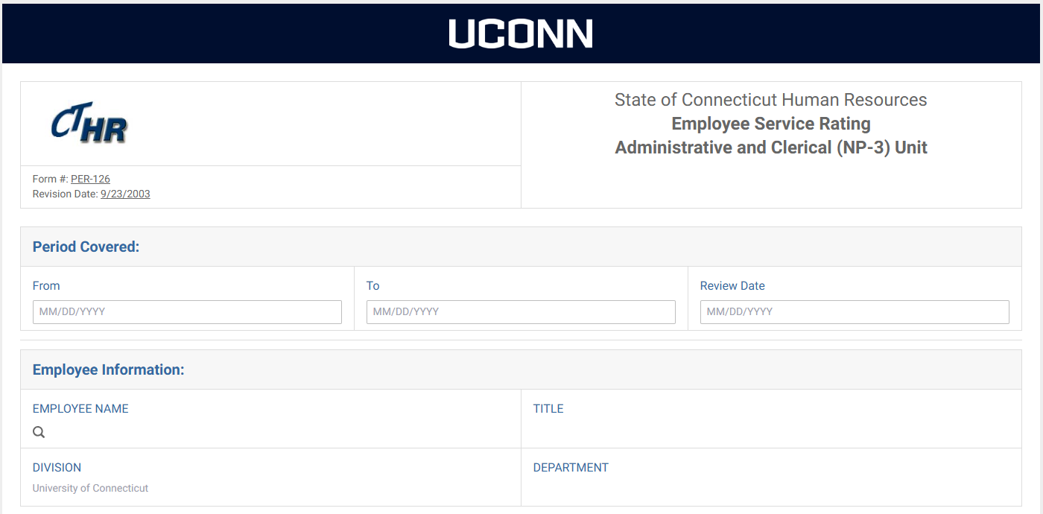
Performance Appraisal
Employee info and period covered (9/1/yyyy-8/31/yyyy)

Slide 15
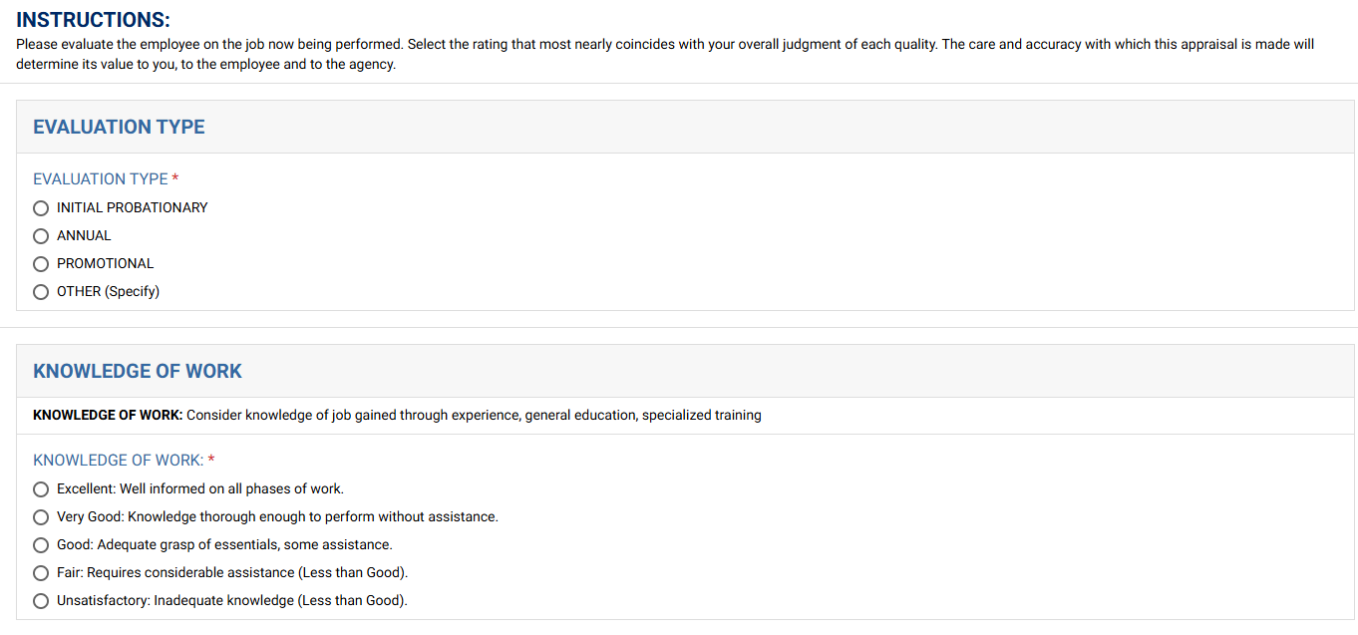
Performance Appraisal
Type of performance appraisal
Job elements and ratings

Slide 16
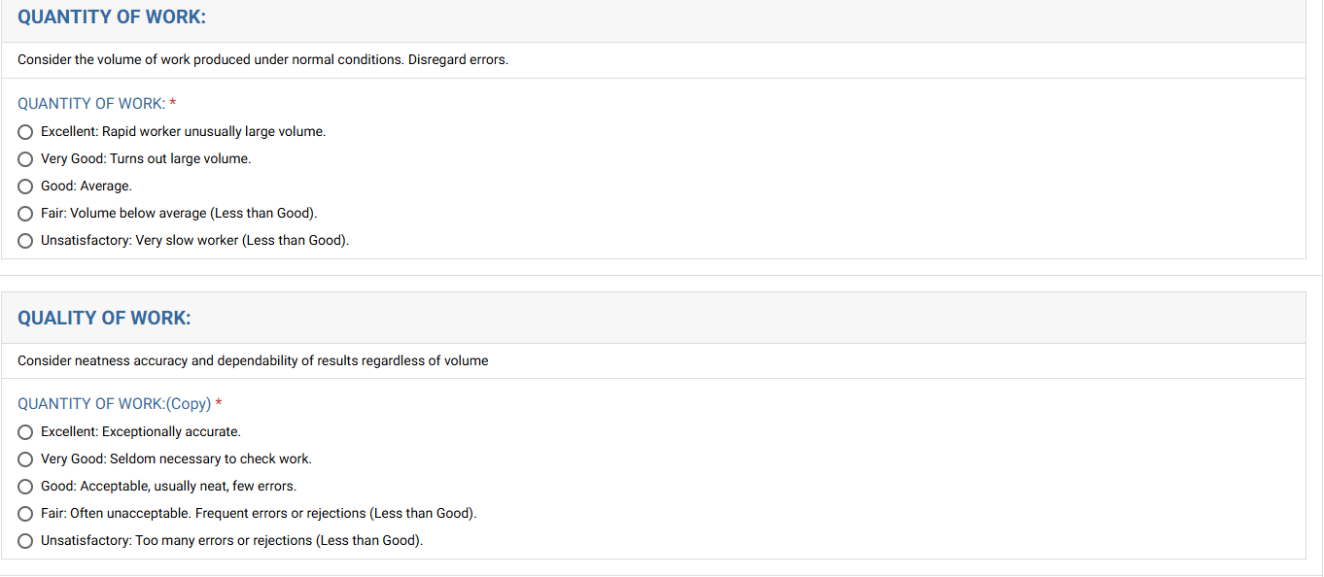
Performance Appraisal
Job elements and ratings

Slide 17
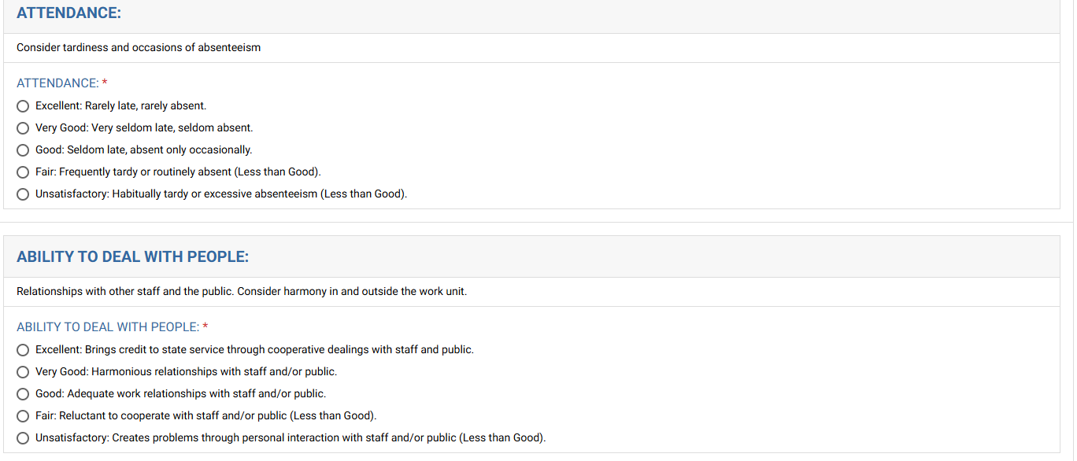
Performance Appraisal
Job elements and ratings

Slide 18
Performance Appraisal
Consequences of “Less Than Good” and “Unsatisfactory” ratings
A “Less Than Good” performance appraisal may mean that an employee is not eligible for an anniversary increase, promotion or transfer. The supervisor should make it known to the Office of Faculty and Staff Labor Relations (laborrelations@uconn.edu or 486-5684) if an increase is to be denied for a LESS THAN GOOD rating.
An “Unsatisfactory” rating may result in the denial of an increase. Two consecutive unsatisfactory ratings, filed within two years of each other, may be cause for dismissal.

Slide 19
Performance Appraisal
“Less Than Good” Performance
Before filing a "less than good" performance appraisal, supervisors should call the Office of Faculty and Staff Labor Relations at ext. 5684 or laborrelations@uconn.edu for guidance.
Supervisors should be able to answer "yes" to the following questions before filing a "less than good" rating:
  Is the employee working within his/her job specification?
  Have the University's and the department's rules, regulations and policies been explained to the employee? Is there documentation as to when and how?
  Has the employee been given adequate training in order to perform his/her duties?
  Have performance problems been pointed out to the employee and suggestions for improvement been made? Is there documentation to show dates of counseling sessions and progressive discipline? Has a letter of warning specifically referencing the possibility of a "less than good" rating been given to the employee?
  Has the employee been given sufficient time and opportunity to improve his/her performance?
  Is the rating an objective evaluation?

Slide 20
Performance Appraisal
Evaluating Attendance
Attendance rating based on:
  The number of days and occasions used on the Sick Leave Usage Table at page 35 of Resolving Employee Performance Problems (https://hr.uconn.edu/resolving-employee-performance-problems/),
  An employee's tardiness record, and
  Any unauthorized leave
Excessive use of sick leave should be evaluated considering the following factors:
  Number of days taken, and number of occasions
  Patterns of usage
  The employee's past record
  The reasons for sick leave use
  Extenuating circumstances
For employees whose attendance needs improvement, copies of counseling letters and/or medical certificate requirements and warnings should be attached to the rating.

Slide 21
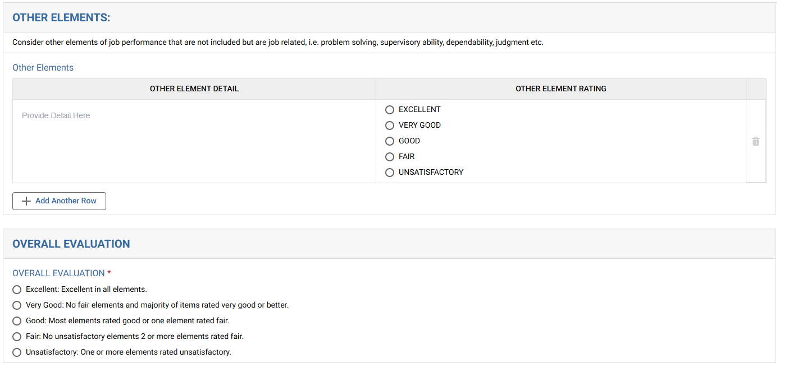
Performance Appraisal
Supervisory feedback and overall evaluation of employee

Slide 22
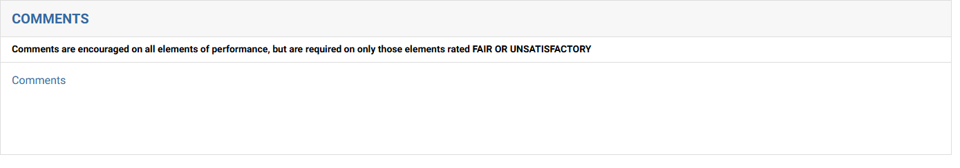
Performance Appraisal
PER-126 Form
Supervisory feedback and overall evaluation of employee
Please be sure to take into consideration discipline that has been documented for this evaluation period

Slide 23
Overall Rating
You will then give an overall evaluation of the employee. You may select:
  Excellent
  Very Good
  Good
  Fair
  Unsatisfactory
Only fair or unsatisfactory ratings may be grieved

Slide 24
“Fair” or “Unsatisfactory” Ratings
A rating of “unsatisfactory” in one category or “fair” in two categories means that the appraisal is considered “less than good”, and you may only make the overall rating “fair” or “unsatisfactory”
When deciding eligibility for an annual increment, a single unsatisfactory or two (2) fair ratings may be considered grounds for denial of such step

Slide 25
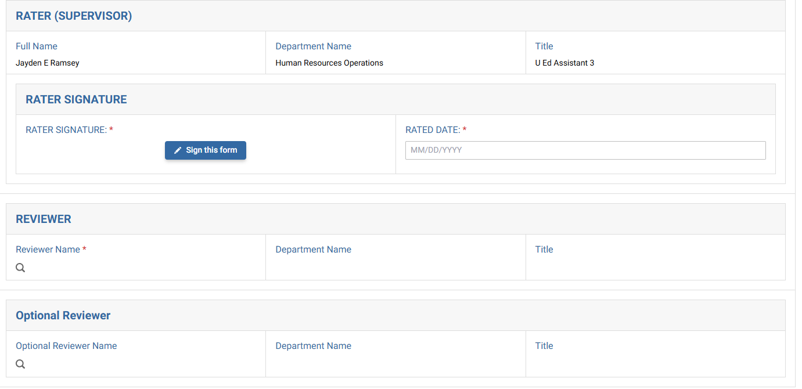
Performance Appraisal
PER-126 Form
Supervisor who completes the evaluation
Appropriate Manager
An optional reviewer within Kuali acknowledges the form; their signature is not included.

Slide 26

Questions?

